Slide 1
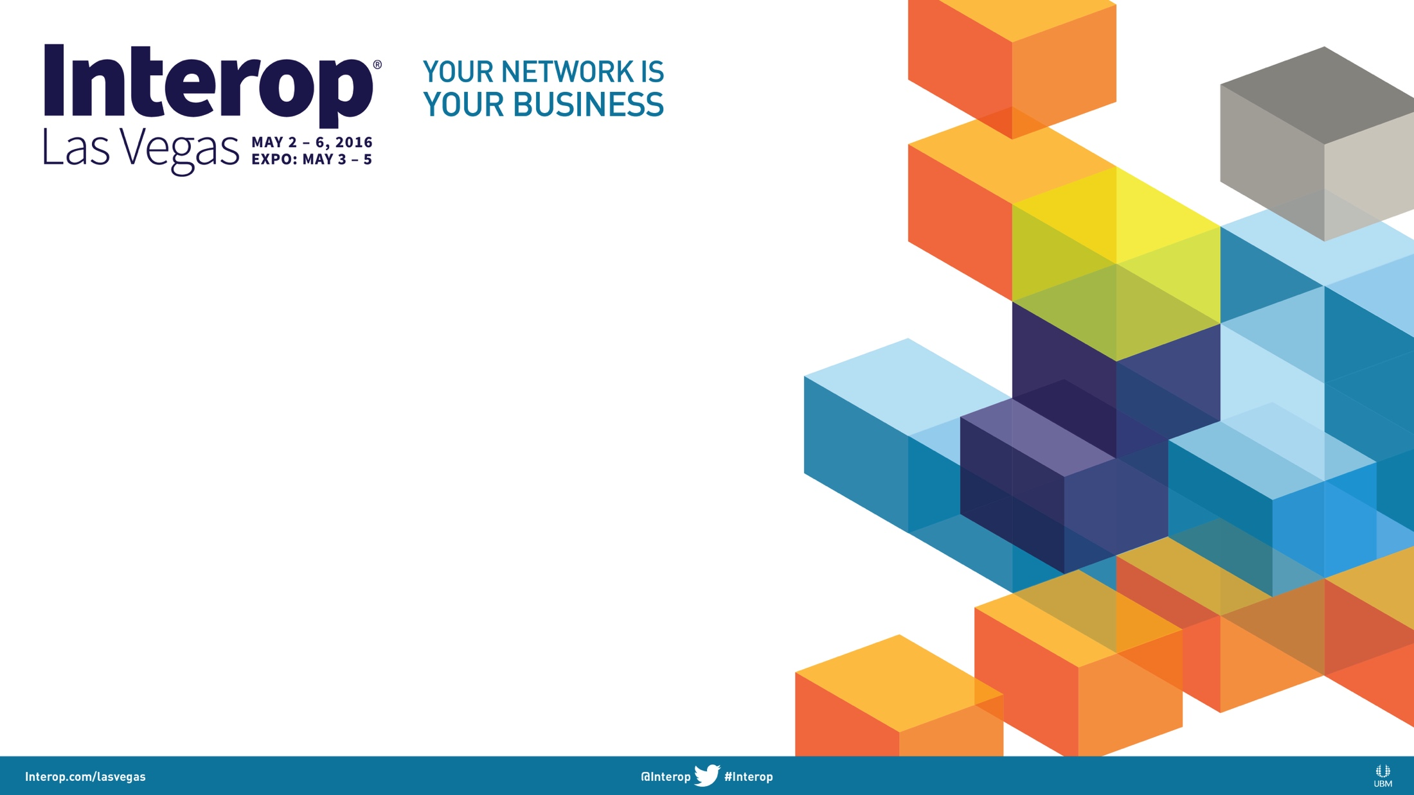
Net DevOps and Change Control
Pete Lumbis - @PeteCCDE
Cumulus Networks Systems Engineer
CCIE #28677, CCDE 2012::3

Slide 2
Agenda
Change Management Today
The Problems Today
NetDevOps Toolkit
Tying it All Together (vDemo)

Slide 3

Pete Who?
CCIE R&S, CCDE (First in Cisco Support)
Former Cisco TAC Routing Escalation
Current Cumulus Networks SE/Architect
Network Engineer, Not a Programmer
Notes:
Most of these concepts were new to me within the last 12 months. My background has always been bits and bytes and living in packets and building networks. Even non-programmers can use these tools.

Slide 4
Leading Questions
Who thinks their change system works well?

Slide 5
Leading Questions
Who thinks their change system works well?
I assume your manager is here

Slide 6
Leading Questions
Who thinks their change system works well?
I assume your manager is here
Who lab tests 100% of changes?

Slide 7
Leading Questions
Who thinks their change system works well?
I assume your manager is here
Who lab tests 100% of changes?
Who checks servers + apps on changes?

Slide 8
Leading Questions
Who thinks their change system works well?
I assume your manager is here
Who lab tests 100% of changes?
Who checks servers + apps on changes?
Why is it your users?

Slide 9
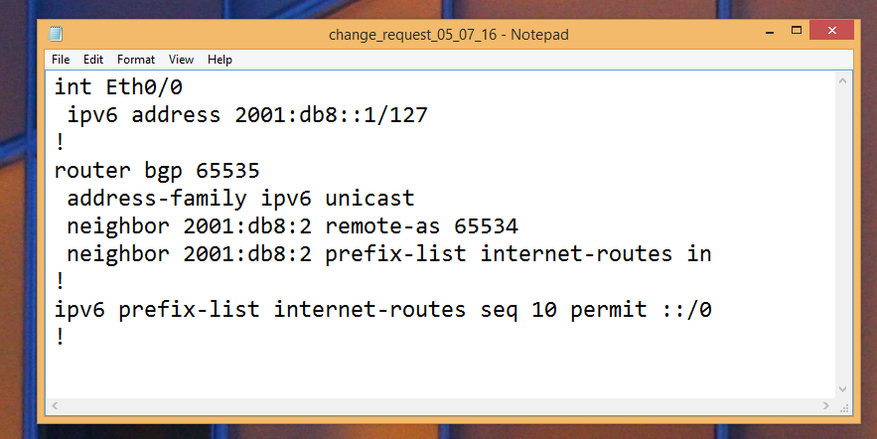
Change Management Today
Notes:
2001:db8:2 is an invalid IPv6 address. Some implementations will expand to 2001:db8:2:: however this is still not the correct BGP peer (2001:db8::2 would be the other end of the point to point connection described)

Slide 10
Change Management Today
Monday, 9:30am: Write Change, Email Team
Notes:
2001:db8:2 is an invalid IPv6 address. Some implementations will expand to 2001:db8:2:: however this is still not the correct BGP peer (2001:db8::2 would be the other end of the point to point connection described)

Slide 11
Change Management Today
Monday, 9:30am: Write Change, Email Team
Thursday, 9:00am: Ask team if they read email
Notes:
2001:db8:2 is an invalid IPv6 address. Some implementations will expand to 2001:db8:2:: however this is still not the correct BGP peer (2001:db8::2 would be the other end of the point to point connection described)

Slide 12
Change Management Today
Monday, 9:30am: Write Change, Email Team
Thursday, 9:00am: Ask team if they read email
Friday, 11:00am:
Receive “looks good” from lead
Notes:
2001:db8:2 is an invalid IPv6 address. Some implementations will expand to 2001:db8:2:: however this is still not the correct BGP peer (2001:db8::2 would be the other end of the point to point connection described)

Slide 13
Change Management Today
Monday, 9:30am: Write Change, Email Team
Thursday, 9:00am: Ask team if they read email
Friday, 11:00am:
Receive “looks good” from lead
Saturday, 10:00pm: Implement Change in 2 hr window
Notes:
2001:db8:2 is an invalid IPv6 address. Some implementations will expand to 2001:db8:2:: however this is still not the correct BGP peer (2001:db8::2 would be the other end of the point to point connection described)

Slide 14
Change Management Today
Monday, 9:30am: Write Change, Email Team
Thursday, 9:00am: Ask team if they read email
Friday, 11:00am:
Receive “looks good” from lead
Saturday, 10:00pm: Implement Change in 2 hr window
Sunday, 8:30am: Notice Typo, Fix. Go home.
Notes:
2001:db8:2 is an invalid IPv6 address. Some implementations will expand to 2001:db8:2:: however this is still not the correct BGP peer (2001:db8::2 would be the other end of the point to point connection described)

Slide 15
Change Validation

Slide 16

Change Validation

Slide 17
Validation? What Validation?

Slide 18
Validation? What Validation?
Best Case
- 30 person bridge
- Every department signs off

Slide 19
Validation? What Validation?
Best Case
- 30 person bridge
- Every department signs off
Worst Case
- Ping some things
- Watch for tickets

Slide 20
Validation? What Validation?

Slide 21
Validation? What Validation?
Is ping your business application?

Slide 22
Recap: What’s Broken?
Notes:
Poor change communication – the process that is in place to notify and understand changes is error prone and tends to not lend to strong collaboration
Difficult to test outside of production – Labs are prohibitively expensive and most virtual tools are garbage. Virtual tools are getting better but the virtual environment must be 100% match to the actual features of production devices.
Poor change validation - We simply ping or traceroute to verify that things work. Network changes rarely do much work to validate that the network change provided the desired business outcome that it should.
Manual validation doesn’t scale – Due to manual validation process it’s nearly impossible to test tens, let alone hundreds of elements. We can’t test every webserver in the cluster or ping every IP of every device in the datacenter.
Silos of Excellence – Network engineers think about the network. Systems engineers think about servers. We must get out of this mindset that these interconnected systems are islands.

Slide 23
Recap: What’s Broken?
Poor change communication
Notes:
Poor change communication – the process that is in place to notify and understand changes is error prone and tends to not lend to strong collaboration
Difficult to test outside of production – Labs are prohibitively expensive and most virtual tools are garbage. Virtual tools are getting better but the virtual environment must be 100% match to the actual features of production devices.
Poor change validation - We simply ping or traceroute to verify that things work. Network changes rarely do much work to validate that the network change provided the desired business outcome that it should.
Manual validation doesn’t scale – Due to manual validation process it’s nearly impossible to test tens, let alone hundreds of elements. We can’t test every webserver in the cluster or ping every IP of every device in the datacenter.
Silos of Excellence – Network engineers think about the network. Systems engineers think about servers. We must get out of this mindset that these interconnected systems are islands.

Slide 24
Recap: What’s Broken?
Poor change communication
Difficult to test outside of production
Notes:
Poor change communication – the process that is in place to notify and understand changes is error prone and tends to not lend to strong collaboration
Difficult to test outside of production – Labs are prohibitively expensive and most virtual tools are garbage. Virtual tools are getting better but the virtual environment must be 100% match to the actual features of production devices.
Poor change validation - We simply ping or traceroute to verify that things work. Network changes rarely do much work to validate that the network change provided the desired business outcome that it should.
Manual validation doesn’t scale – Due to manual validation process it’s nearly impossible to test tens, let alone hundreds of elements. We can’t test every webserver in the cluster or ping every IP of every device in the datacenter.
Silos of Excellence – Network engineers think about the network. Systems engineers think about servers. We must get out of this mindset that these interconnected systems are islands.

Slide 25
Recap: What’s Broken?
Poor change communication
Difficult to test outside of production
Little change validation
Notes:
Poor change communication – the process that is in place to notify and understand changes is error prone and tends to not lend to strong collaboration
Difficult to test outside of production – Labs are prohibitively expensive and most virtual tools are garbage. Virtual tools are getting better but the virtual environment must be 100% match to the actual features of production devices.
Poor change validation - We simply ping or traceroute to verify that things work. Network changes rarely do much work to validate that the network change provided the desired business outcome that it should.
Manual validation doesn’t scale – Due to manual validation process it’s nearly impossible to test tens, let alone hundreds of elements. We can’t test every webserver in the cluster or ping every IP of every device in the datacenter.
Silos of Excellence – Network engineers think about the network. Systems engineers think about servers. We must get out of this mindset that these interconnected systems are islands.

Slide 26
Recap: What’s Broken?
Poor change communication
Difficult to test outside of production
Little change validation
Manual validation doesn’t scale
Notes:
Poor change communication – the process that is in place to notify and understand changes is error prone and tends to not lend to strong collaboration
Difficult to test outside of production – Labs are prohibitively expensive and most virtual tools are garbage. Virtual tools are getting better but the virtual environment must be 100% match to the actual features of production devices.
Poor change validation - We simply ping or traceroute to verify that things work. Network changes rarely do much work to validate that the network change provided the desired business outcome that it should.
Manual validation doesn’t scale – Due to manual validation process it’s nearly impossible to test tens, let alone hundreds of elements. We can’t test every webserver in the cluster or ping every IP of every device in the datacenter.
Silos of Excellence – Network engineers think about the network. Systems engineers think about servers. We must get out of this mindset that these interconnected systems are islands.

Slide 27

Recap: What’s Broken?
Poor change communication
Difficult to test outside of production
Little change validation
Manual validation doesn’t scale
Silos of Excellence
Notes:
Poor change communication – the process that is in place to notify and understand changes is error prone and tends to not lend to strong collaboration
Difficult to test outside of production – Labs are prohibitively expensive and most virtual tools are garbage. Virtual tools are getting better but the virtual environment must be 100% match to the actual features of production devices.
Poor change validation - We simply ping or traceroute to verify that things work. Network changes rarely do much work to validate that the network change provided the desired business outcome that it should.
Manual validation doesn’t scale – Due to manual validation process it’s nearly impossible to test tens, let alone hundreds of elements. We can’t test every webserver in the cluster or ping every IP of every device in the datacenter.
Silos of Excellence – Network engineers think about the network. Systems engineers think about servers. We must get out of this mindset that these interconnected systems are islands.

Slide 28
Imagine a World…

Slide 29
Imagine a World…
Configs are easily shared

Slide 30
Imagine a World…
Configs are easily shared
All changes are automatically tested

Slide 31
Imagine a World…
Configs are easily shared
All changes are automatically tested
Tests include servers and apps

Slide 32
Imagine a World…
Configs are easily shared
All changes are automatically tested
Tests include servers and apps
Tests must pass to reach approvers

Slide 33

Imagine a World…
Configs are easily shared
All changes are automatically tested
Tests include servers and apps
Tests must pass to reach approvers
More drinks with umbrellas

Slide 34

NetDevOps Toolbox
Git
Git – Provides config management and collabration

Slide 35

NetDevOps Toolbox
Git
GitLab
GitLab – Change management and automated testing

Slide 36
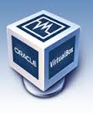

NetDevOps Toolbox
Git
GitLab
Virtual Box
Virtual Box – Hypervisor for lab network + server VMs
Vagrant – Simplifies large Virtual Box environments

Slide 37
NetDevOps Toolbox
Git
GitLab
Virtual Box
Ansible – Applies configuration and manages automation

Slide 38
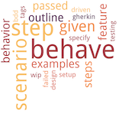
NetDevOps Toolbox
Git
GitLab
Virtual Box
Behave – English based testing language

Slide 39
NetDevOps Toolbox
Git
GitLab
Virtual Box
Configuration Saved to GitLab

Slide 40
NetDevOps Toolbox
Git
GitLab
Virtual Box
GitLab Launches Lab with new configs

Slide 41
NetDevOps Toolbox
Git
GitLab
Virtual Box
Vagrant configures lab with Ansible

Slide 42
NetDevOps Toolbox
Git
GitLab
Virtual Box
GitLab runs Behave tests against infrastructure

Slide 43

vDemo
* Sorta

Slide 44
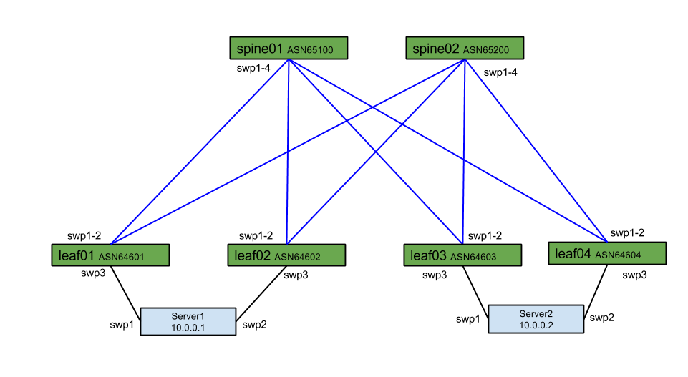
http://gitlab.com/plumbis/interop-2016

Slide 45
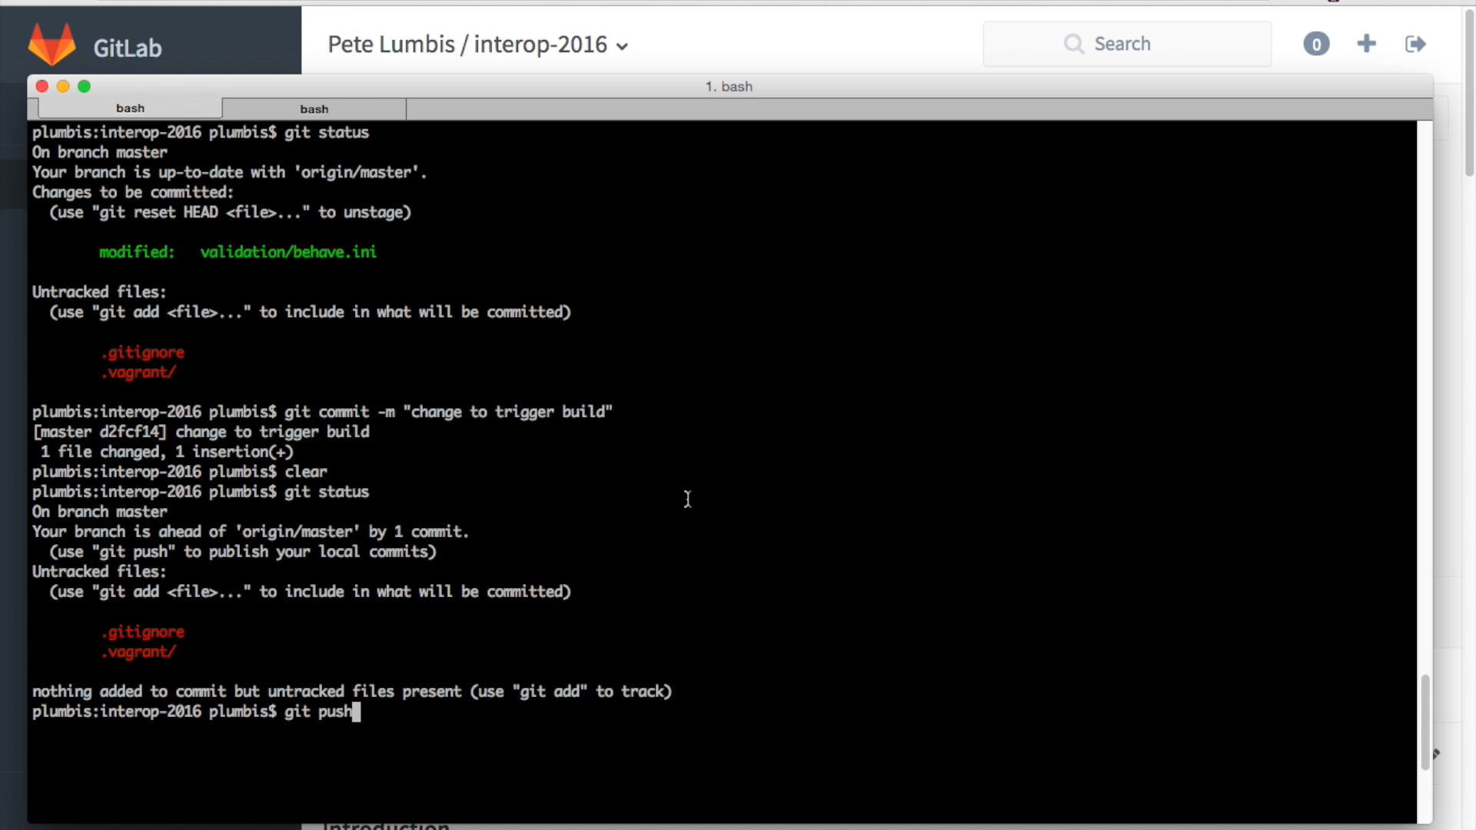
Notes:
First we use “git push” to save a local change to the central git repository. This is is what kickstarts the entire process.

Slide 46
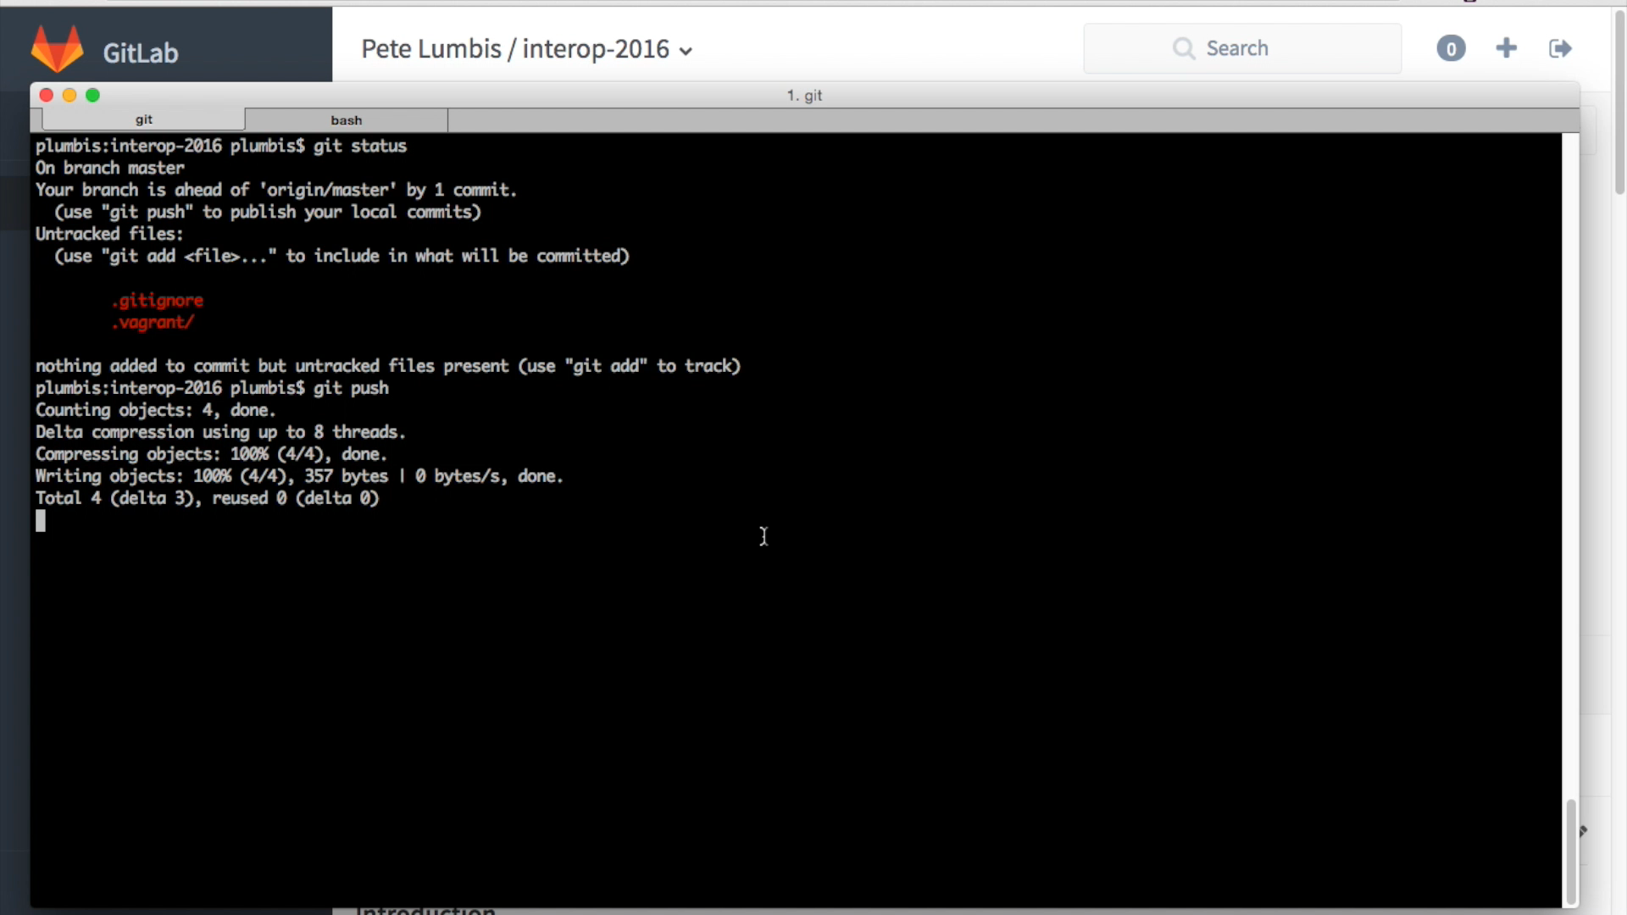
Notes:
Next we go to GitLab where we first see “0 Builds”. Nothing was running, but as we click on the link to refresh we see that the first build has automatically been kicked off. This first test simply checks for valid syntax. After refreshing the page again we see that the syntax test has passed and a second “build” has started that will build the entire virtual lab.

Slide 47
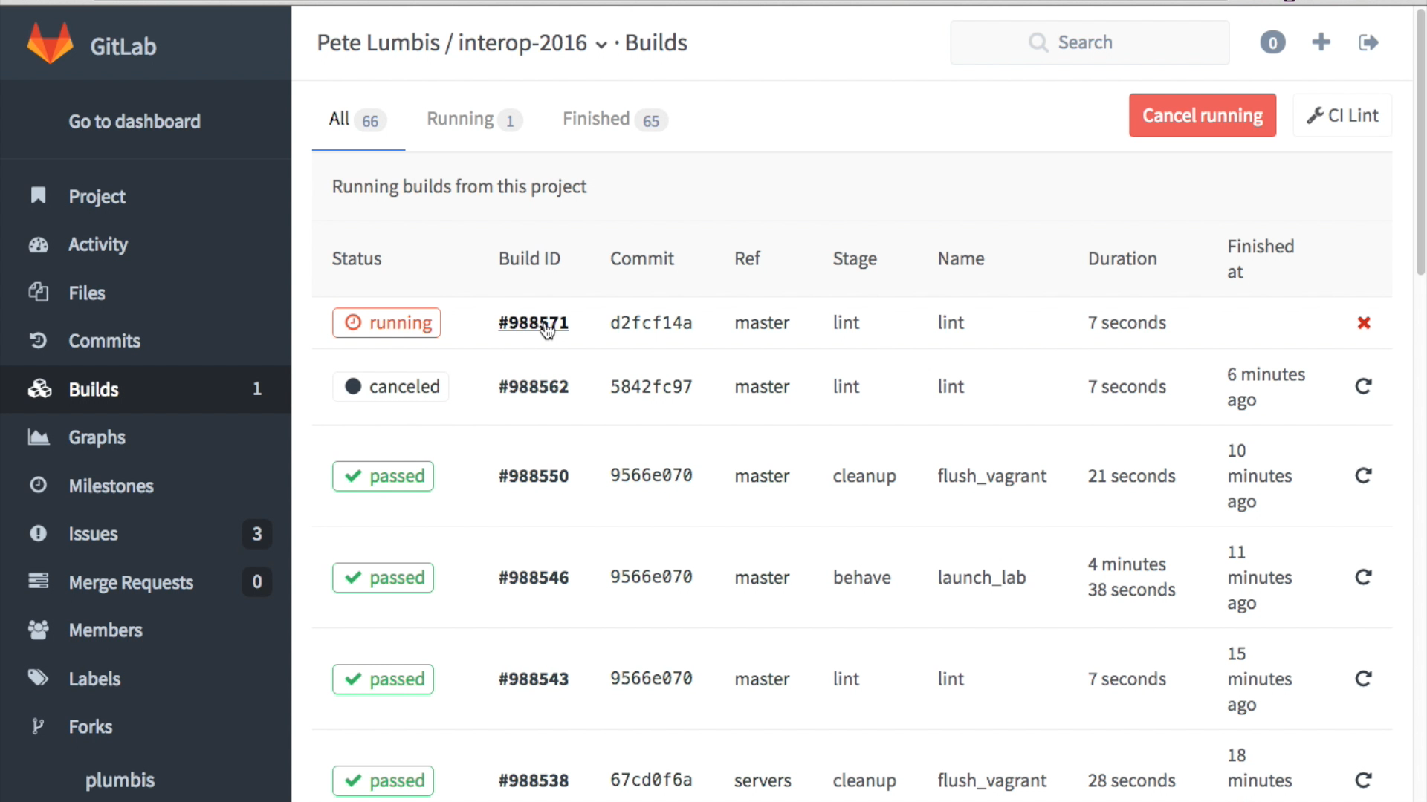
Notes:
Now we see the entire virtual lab being brought up. Vagrant is the tool that orchestrates all of the VMs that run in VirtualBox. The VirtualBox instance can be your local machine, a beefy lab server or even a cloud like AWS or Azure.
You can also see Ansible running to provision the entire environment.

Slide 48
Behave Overview
Notes:
Behave allows for natural language tests. Behave supports a number of languages besides English.
The beauty is that network engineers understand policy and behavior, but may not understand how to parse JSON output. Behave allows network engineers to define policy and a small amount of work by a developer can build the python code that runs behind the scenes to validate this each test.
On the left we see a successful behave run. On the right we see a test that has failed because the swp1 interface on spine1 is down and the BGP peer is in the Idle state.

Slide 49
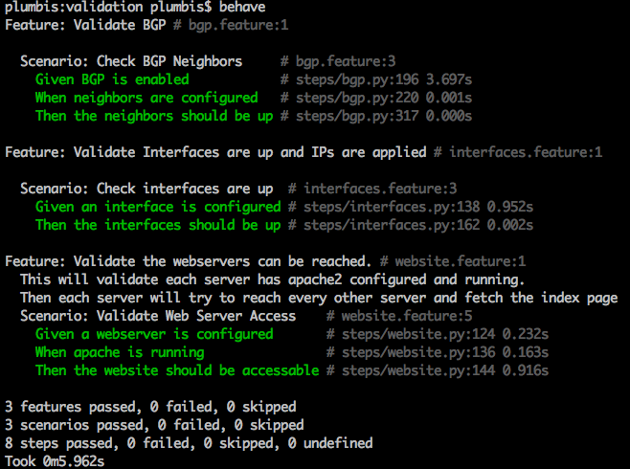
Behave Overview
Notes:
Behave allows for natural language tests. Behave supports a number of languages besides English.
The beauty is that network engineers understand policy and behavior, but may not understand how to parse JSON output. Behave allows network engineers to define policy and a small amount of work by a developer can build the python code that runs behind the scenes to validate this each test.
On the left we see a successful behave run. On the right we see a test that has failed because the swp1 interface on spine1 is down and the BGP peer is in the Idle state.

Slide 50
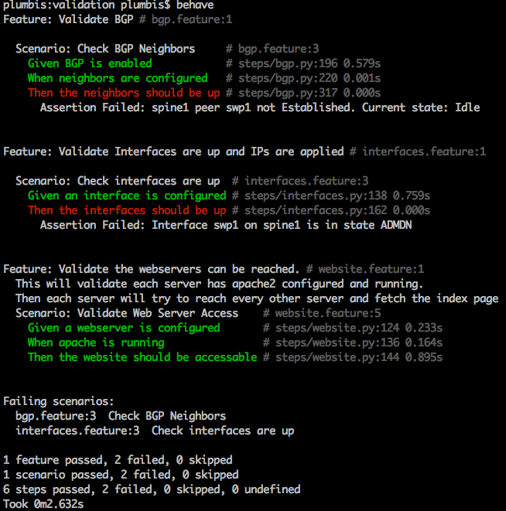
Behave Overview
Notes:
Behave allows for natural language tests. Behave supports a number of languages besides English.
The beauty is that network engineers understand policy and behavior, but may not understand how to parse JSON output. Behave allows network engineers to define policy and a small amount of work by a developer can build the python code that runs behind the scenes to validate this each test.
On the left we see a successful behave run. On the right we see a test that has failed because the swp1 interface on spine1 is down and the BGP peer is in the Idle state.

Slide 51
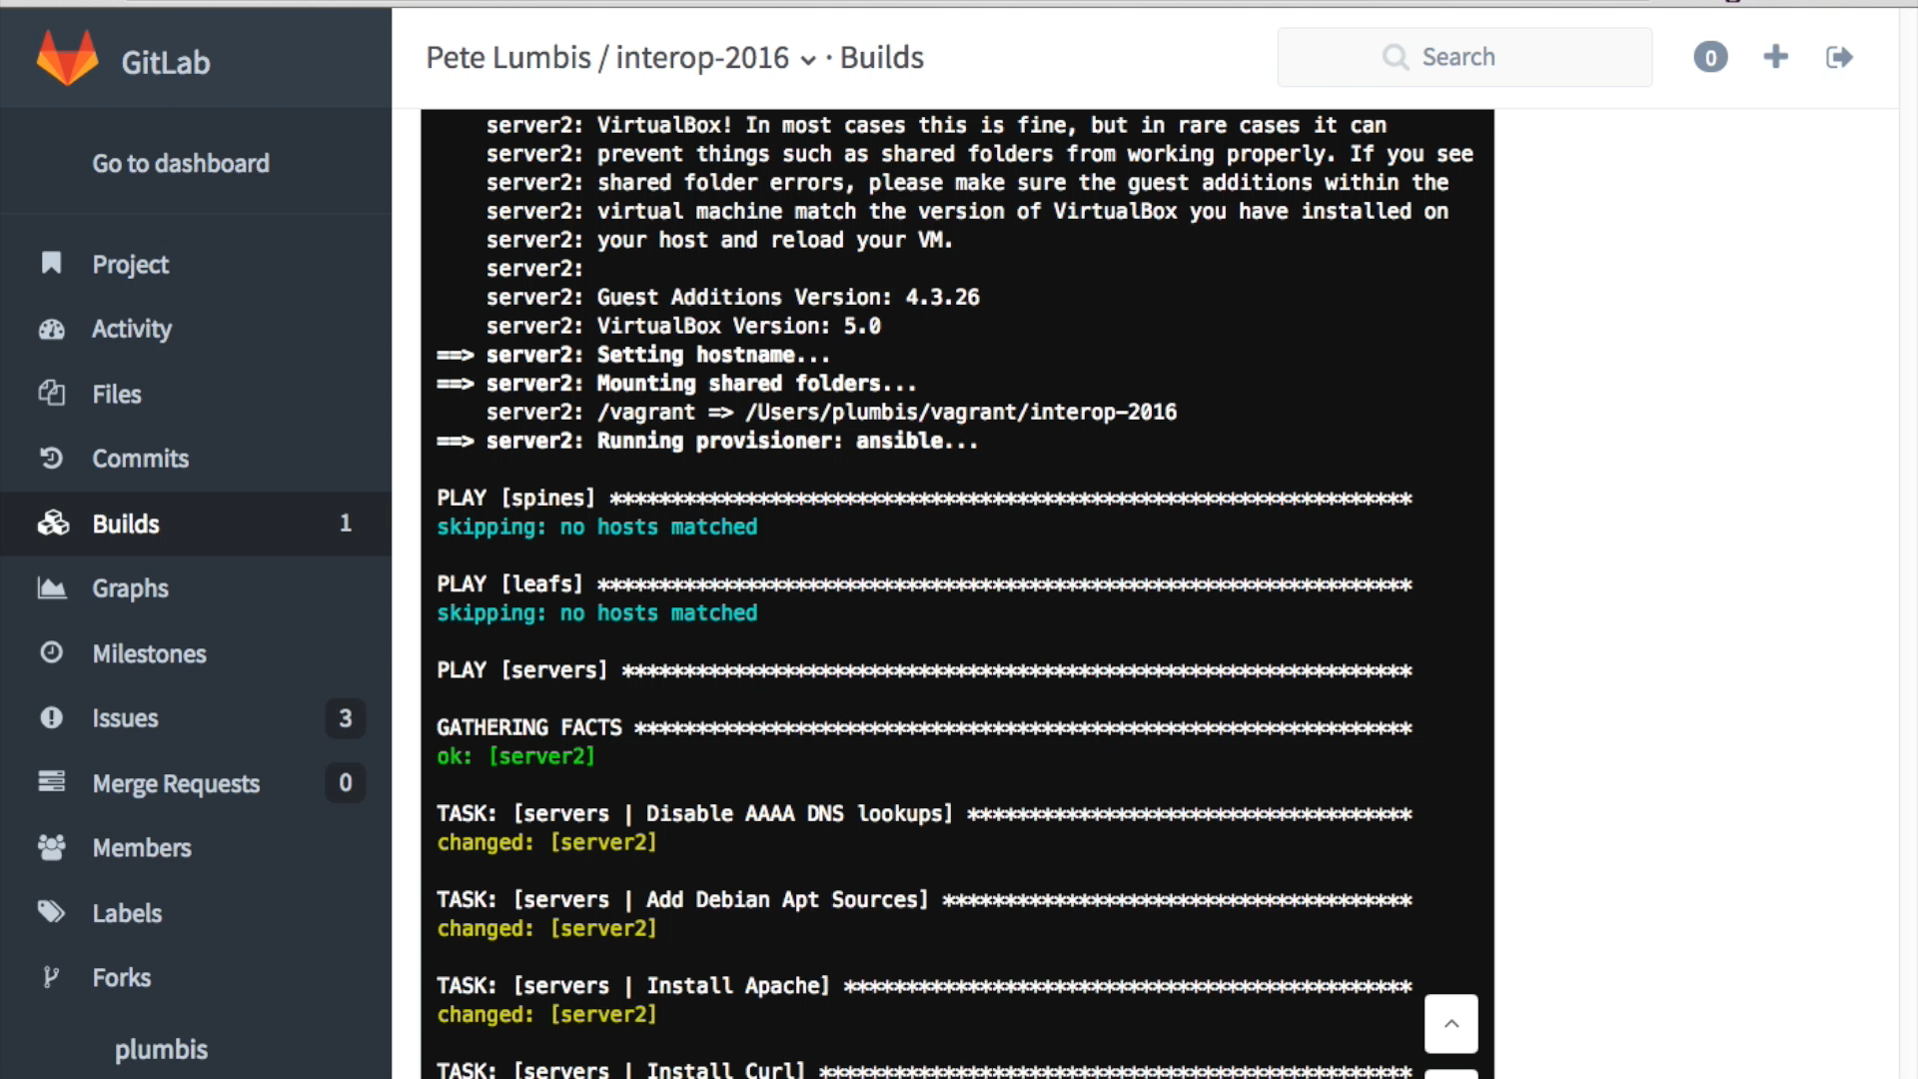
Notes:
Finally, at the end of the provisioning process you can see the Behave tests execute and show that everything passed. Our proposed network change worked. Not only did it do what we expect on the network, but it had no negative impact on the servers and applications (Apache webservers in this example).

Slide 52
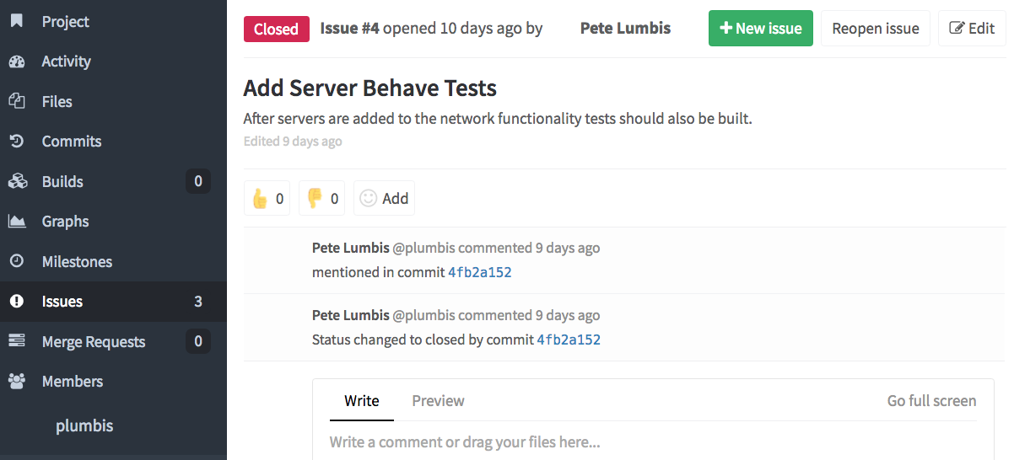
GitLab Ticketing
Notes:
GitLab provides “issues” where changes and problems are reported.

Slide 53
GitLab Ticketing
Notes:
Thumbs Up/ Thumbs Down can be added for approval, as well as a minimum number of approvers.

Slide 54
GitLab Ticketing
Notes:
When an issue is mentioned in the commit (saving) of configuration to Git it is auto linked to the ticket. You can also click on the commit ID for more info about that commit.

Slide 55
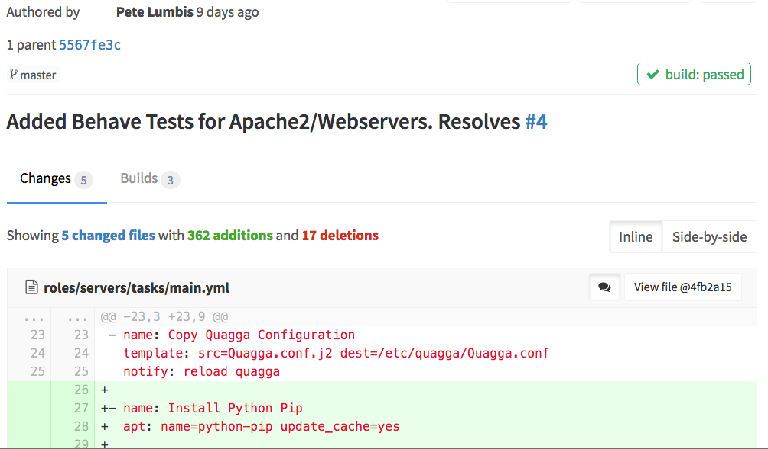
GitLab Changes
Notes:
This is the commit that was auto linked in the ticket.

Slide 56
GitLab Changes
Notes:
We can see the comment that was provided when the change was made.

Slide 57
GitLab Changes
Notes:
We can see everything that was touched. Here we see 5 files were modified, totaling 362 lines of added config.

Slide 58
GitLab Changes
Notes:
Here we see that when this commit was issued the build automatically ran and tested these changes. We can quickly look and see that the test cases passed.

Slide 59

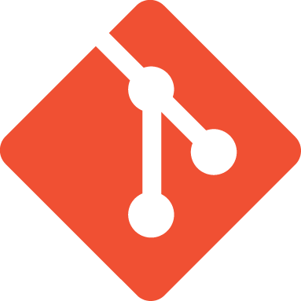

NetDevOps Toolbox Alternatives
Git
GitLab
Notes:
Git is the tool to use, however GitLab, GitHub, and Atlassian Bitbucket (formerly Stash) are all valid tools to use for Git

Slide 60

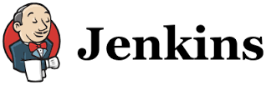

NetDevOps Toolbox Alternatives
GitLab
Notes:
GitLab as the CI/CD tool can easily be replaced with Bamboo, Jenkins, TravisCI or any other build tool.

Slide 61



NetDevOps Toolbox Alternatives
Virtual Box
Notes:
VirtualBox as a Hypervisor can be replaced with VMWare, HyperV, KVM or any other hypervisor that has a virtual image for your device

Slide 62
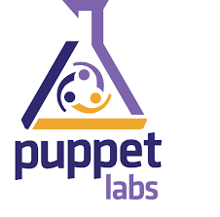
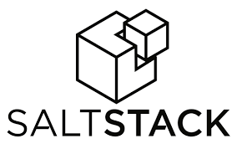

NetDevOps Toolbox Alternatives
Notes:
Ansible as an automation tool could be replaced with Puppet, Chef, Saltstack, or anything else.

Slide 63
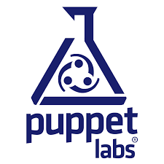


NetDevOps Toolbox Alternatives
Beaker
Matt Oswalt’s ToDD
Notes:
Behave as a testing tool could be replaced with Beaker from Puppet Labs, Test Kitchen from KitchenCI or the new ToDD from Matt Oswalt.

Slide 64
Wrap Up
Notes:
When we keep the configuration to build our networks offline we can use tools like Git and Ansible to easily spin up virtual environments, this is the concept of infrastructure as code.
A key component to this is the use of automation, so we can quickly and simply bring up these virtual environments for testing.
But it’s key to remember that testing must include servers and applications. Networks exist to provide a way for applications to operate on top of the network. The network doesn’t live in isolation.
Finally, not all vendors can provide this kind of tooling. It is up to customers to push their vendors for better tools. Vendors listen to money. Tell them they need better ways to support automation and this kind of lifecycle development. Server Admins have been doing it for years, why do network admins have to suffer?

Slide 65
Wrap Up
There’s a better way!
Notes:
When we keep the configuration to build our networks offline we can use tools like Git and Ansible to easily spin up virtual environments, this is the concept of infrastructure as code.
A key component to this is the use of automation, so we can quickly and simply bring up these virtual environments for testing.
But it’s key to remember that testing must include servers and applications. Networks exist to provide a way for applications to operate on top of the network. The network doesn’t live in isolation.
Finally, not all vendors can provide this kind of tooling. It is up to customers to push their vendors for better tools. Vendors listen to money. Tell them they need better ways to support automation and this kind of lifecycle development. Server Admins have been doing it for years, why do network admins have to suffer?

Slide 66
Wrap Up
There’s a better way!
Infrastructure as code
Notes:
When we keep the configuration to build our networks offline we can use tools like Git and Ansible to easily spin up virtual environments, this is the concept of infrastructure as code.
A key component to this is the use of automation, so we can quickly and simply bring up these virtual environments for testing.
But it’s key to remember that testing must include servers and applications. Networks exist to provide a way for applications to operate on top of the network. The network doesn’t live in isolation.
Finally, not all vendors can provide this kind of tooling. It is up to customers to push their vendors for better tools. Vendors listen to money. Tell them they need better ways to support automation and this kind of lifecycle development. Server Admins have been doing it for years, why do network admins have to suffer?

Slide 67
Wrap Up
There’s a better way!
Infrastructure as code
Automate all the things
Notes:
When we keep the configuration to build our networks offline we can use tools like Git and Ansible to easily spin up virtual environments, this is the concept of infrastructure as code.
A key component to this is the use of automation, so we can quickly and simply bring up these virtual environments for testing.
But it’s key to remember that testing must include servers and applications. Networks exist to provide a way for applications to operate on top of the network. The network doesn’t live in isolation.
Finally, not all vendors can provide this kind of tooling. It is up to customers to push their vendors for better tools. Vendors listen to money. Tell them they need better ways to support automation and this kind of lifecycle development. Server Admins have been doing it for years, why do network admins have to suffer?

Slide 68
Wrap Up
There’s a better way!
Infrastructure as code
Automate all the things
Testing must include applications
Notes:
When we keep the configuration to build our networks offline we can use tools like Git and Ansible to easily spin up virtual environments, this is the concept of infrastructure as code.
A key component to this is the use of automation, so we can quickly and simply bring up these virtual environments for testing.
But it’s key to remember that testing must include servers and applications. Networks exist to provide a way for applications to operate on top of the network. The network doesn’t live in isolation.
Finally, not all vendors can provide this kind of tooling. It is up to customers to push their vendors for better tools. Vendors listen to money. Tell them they need better ways to support automation and this kind of lifecycle development. Server Admins have been doing it for years, why do network admins have to suffer?

Slide 69
Wrap Up
There’s a better way!
Infrastructure as code
Automate all the things
Testing must include applications
Push your vendor. Vote with $$
Notes:
When we keep the configuration to build our networks offline we can use tools like Git and Ansible to easily spin up virtual environments, this is the concept of infrastructure as code.
A key component to this is the use of automation, so we can quickly and simply bring up these virtual environments for testing.
But it’s key to remember that testing must include servers and applications. Networks exist to provide a way for applications to operate on top of the network. The network doesn’t live in isolation.
Finally, not all vendors can provide this kind of tooling. It is up to customers to push their vendors for better tools. Vendors listen to money. Tell them they need better ways to support automation and this kind of lifecycle development. Server Admins have been doing it for years, why do network admins have to suffer?

Slide 70
Questions?

Slide 71
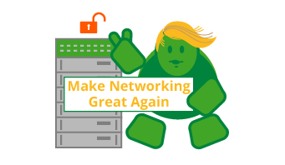
Thank You!
@PeteCCDE
http://gitlab.com/plumbis/interop-2016

Slide 72
Automation Tools - Ansible
Configuration Management Software
Manages SSH connections
Large collection of libraries for common tasks
Human Readable
Notes:
Ansible does not require anything to be installed on the end host it operates on. It uses SSH to connect to the host and execute python code, but can also run locally if the remote device does not support python.

Slide 73
Automation Tools - Ansible
- name: Disable AAAA DNS lookups
replace:
dest=/etc/gai.conf
regexp="#precedence ::ffff:0:0/96 10"
replace="precedence ::ffff:0:0/96 100”
- name: Install Apache
apt: name=apache2 update_cache=yes
notify: restart apache
- name: Copy /etc/network/interfaces
template: src=interfaces.j2 dest=/etc/network/interfaces
notify: reload networking
Notes:
Ansible “plays” and “playbooks” are written in YAML, which is a simple, human readable coding language. Ansible provides a large number of libraries to simplify common tasks, like copying files, installing applications or executing a find and replace inside a text file.

Slide 74
Automation Tools - Git
Source Code text file repository
Automatic file revision/change management
Built for teams to work on the same files
Easy to get started, lots of knobs for advanced users
Notes:
Git (often used through GitHub) is the source code control tool. Although designed for source code, really it manages changes in text files, so it can easily be extended to network configurations.

Slide 75

Automation Tools - Git Cont’d
Remote Repository – Central Server hosting files
Local Repository – Your local copy of the remote. Where you change things
Branch – Isolated copy for new features, risky changes
Merge – Apply branch changes to master repository copy (see also: “Pull Request”)

Slide 76
Automation Tools - Git Cont’d
Create Changes in Branches
master
IPv6
Merge and Review Changes
Use merge/pull request as an opportunity to review impact of changes
master
IPv6

Slide 77

Automation Tools – Git Cont’d
Rollback failures after merge
master
IPv6
For for new project/datacenter/office
east-dc
west-dc

Slide 78
Infrastructure as Code
+
Use software practices for device configurations
All configuration changes tracked and shared
Easy to replace and spin up devices

Slide 79

IaC - Vagrant + VirtualBox
Free hypervisor
Windows/Mac/Linux support
Orchestrates VirtualBox
Define full datacenter of VMs
One click spin up / spin down
Notes:
VirtualBox can be replaced by other hypervisors, but the fact it’s free makes it attracting.
Vagrant’s strength is the ability to bring up multiple VMs and network them together in a pre-defined fashion automatically.

Slide 80
Continuous Integration / Continuous Development
CI/CD
CI – Make lots of production changes
Probably not good for networks
CD – Make lots of small config changes
Test Early, Test Often
Notes:
CI/CD is all the rage within the DevOps community. CI, or lots of changes throughout the day, does not make sense in most environments for networking, but CD, or the ability to test with any proposed change, should be used in every network environment.

Slide 81

CI/CD Pipeline
Tools designed to automate tests
Hook into Git(hub)
Very flexible, highly customizable

Slide 82
Network DevOps
DevOps is about culture
Developers and Operators working together
Where are the network engineers?
Death to the silo!
Network + Dev + Ops
Unique skills, collaboration is key!

